Slide 1

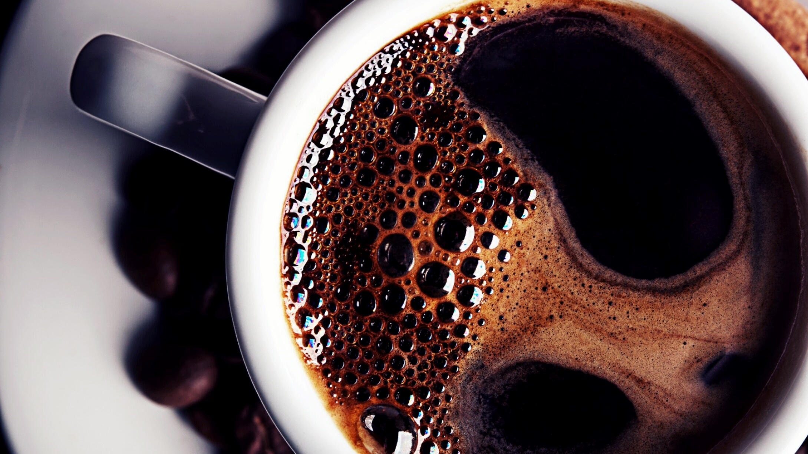
Restaurant Manager
Aidan Sharpe

Slide 2
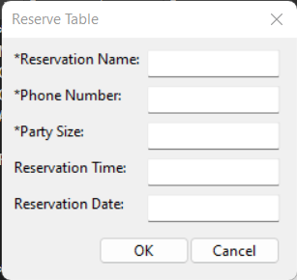
Key Features
Future reservations
Walk-ins
Edit reservations
Add tables to the restaurant
View the reservation status of each table
Demo!

Slide 3

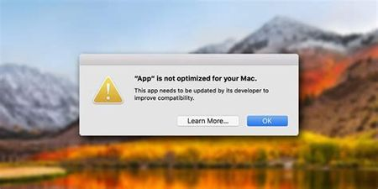
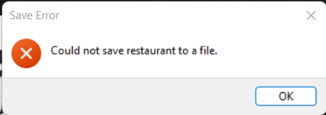
Making the GUI

Slide 4
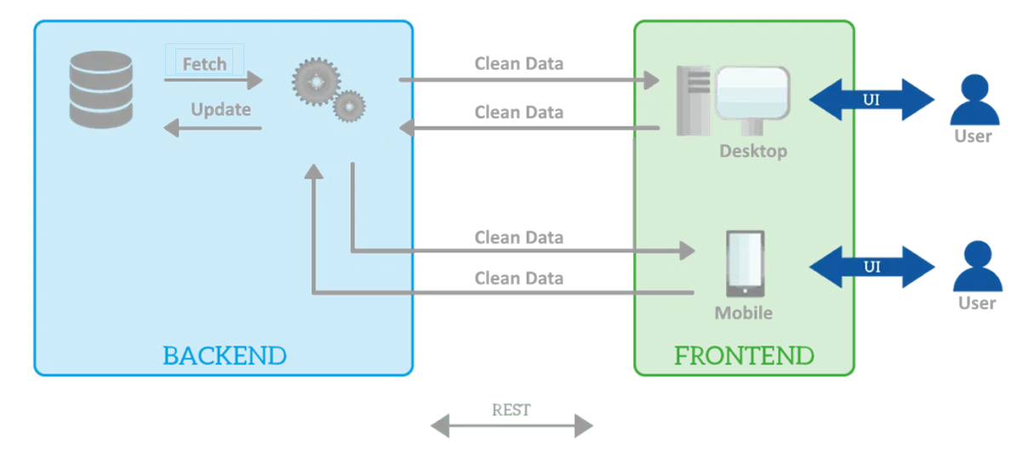
Structuring the Application
Frontend-Backend Model
Restaurant class vs. cMain class
Separating form and function

Slide 5
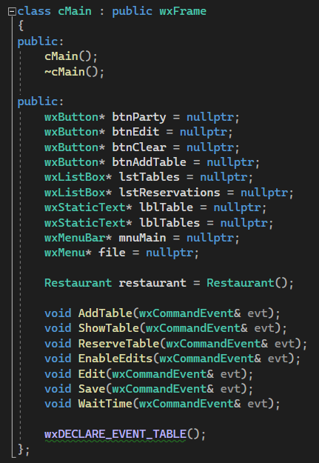
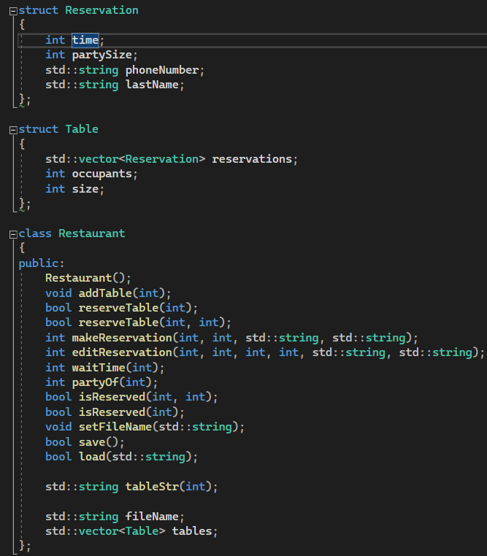
Frontend vs Backend
Notes:
Frontend
GUI Elements
Void (action) functions
Backend
Data structs
Data control
Computational functions

Slide 6
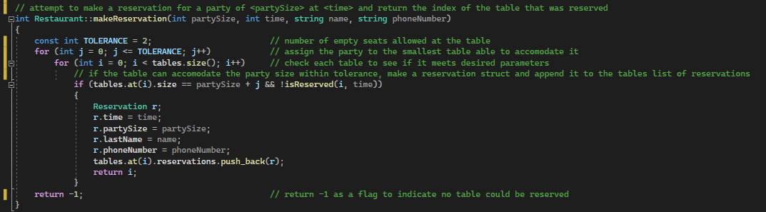
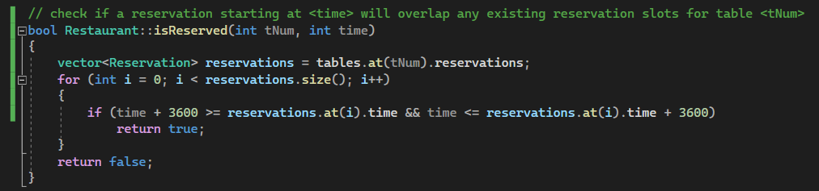
Making Reservations
Notes:
Line-by-line walkthrough

Slide 7
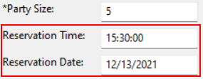

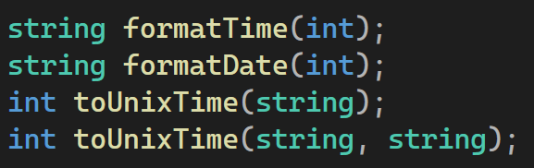
Timing
Make sure reservations don’t overlap
Finding available tables
Displaying times to the user
Three primary time-based functions

Slide 8
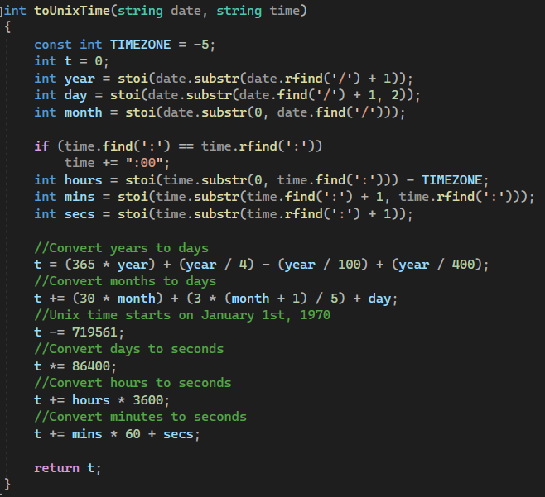
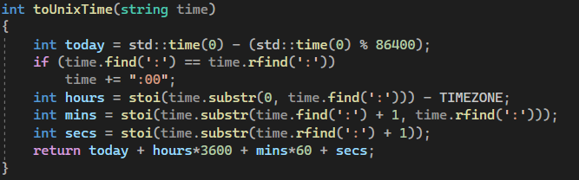
Converting to Unix Time
What is Unix Epoch Time
Why is it useful
Notes:
Unix Epoch Time
Seconds since beginning of 1970
Advent of “home computing”

Slide 9
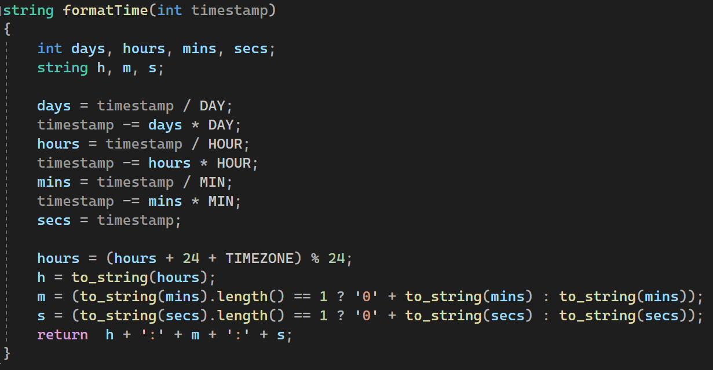
Formatting in 24-hr Time

Slide 10
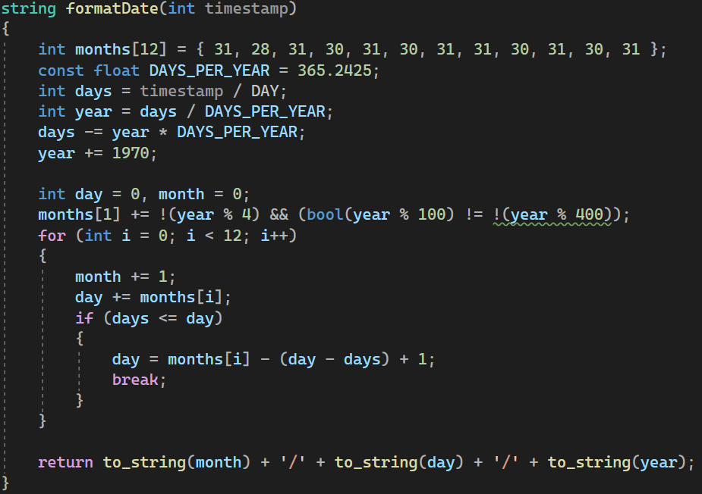
Formatting a Date

